Slide 1

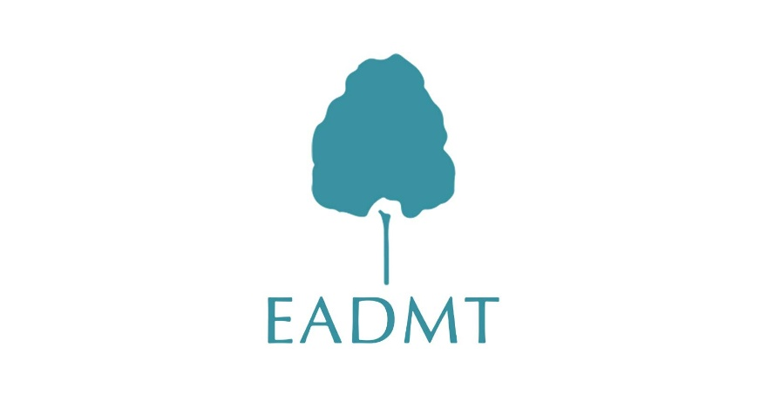






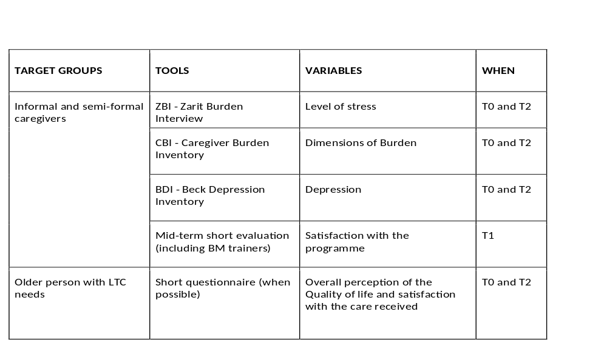
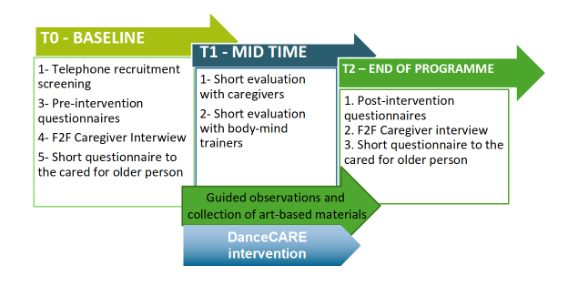
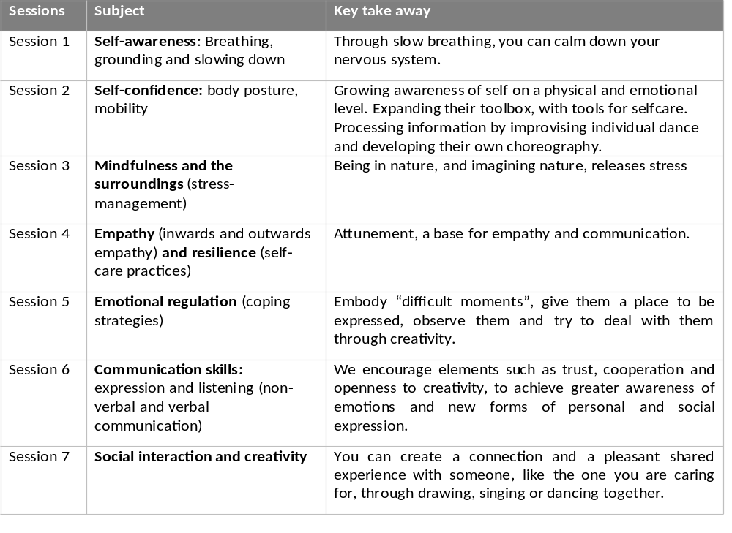
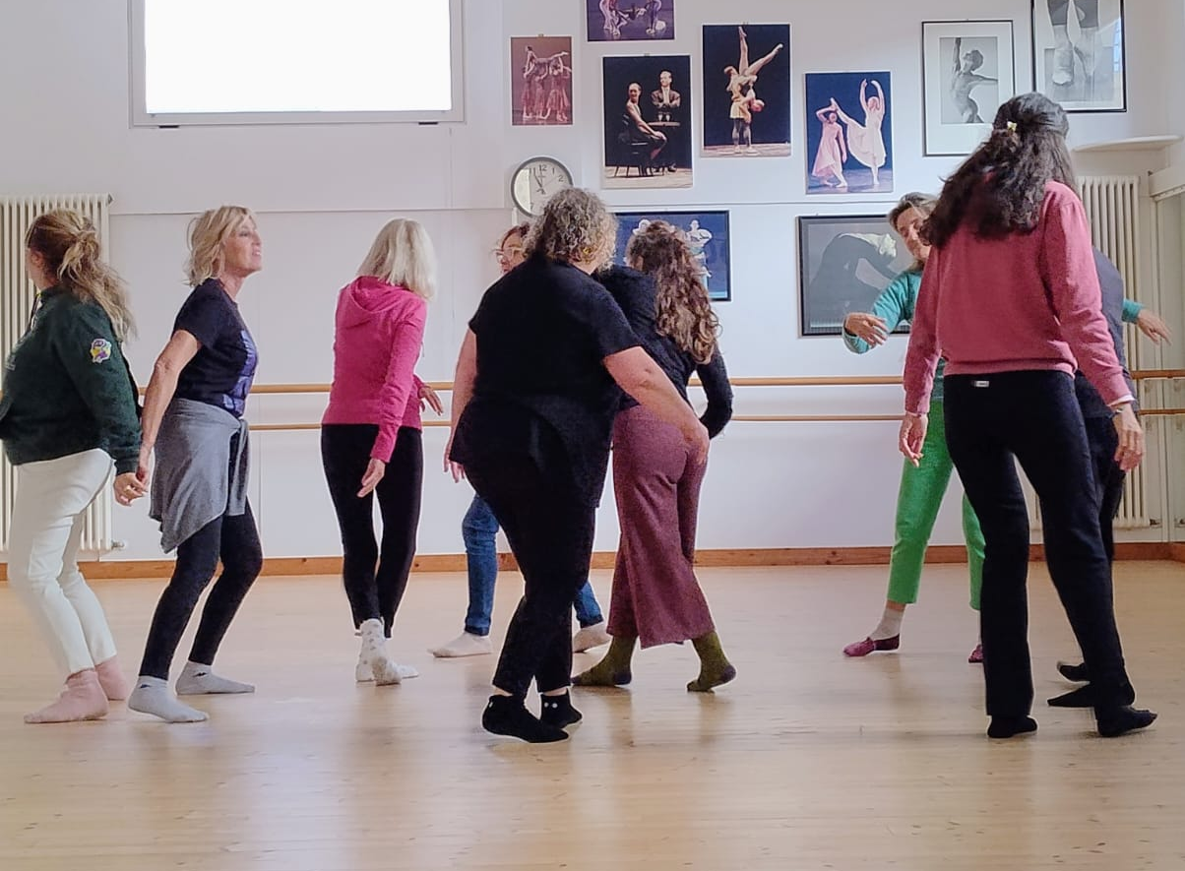
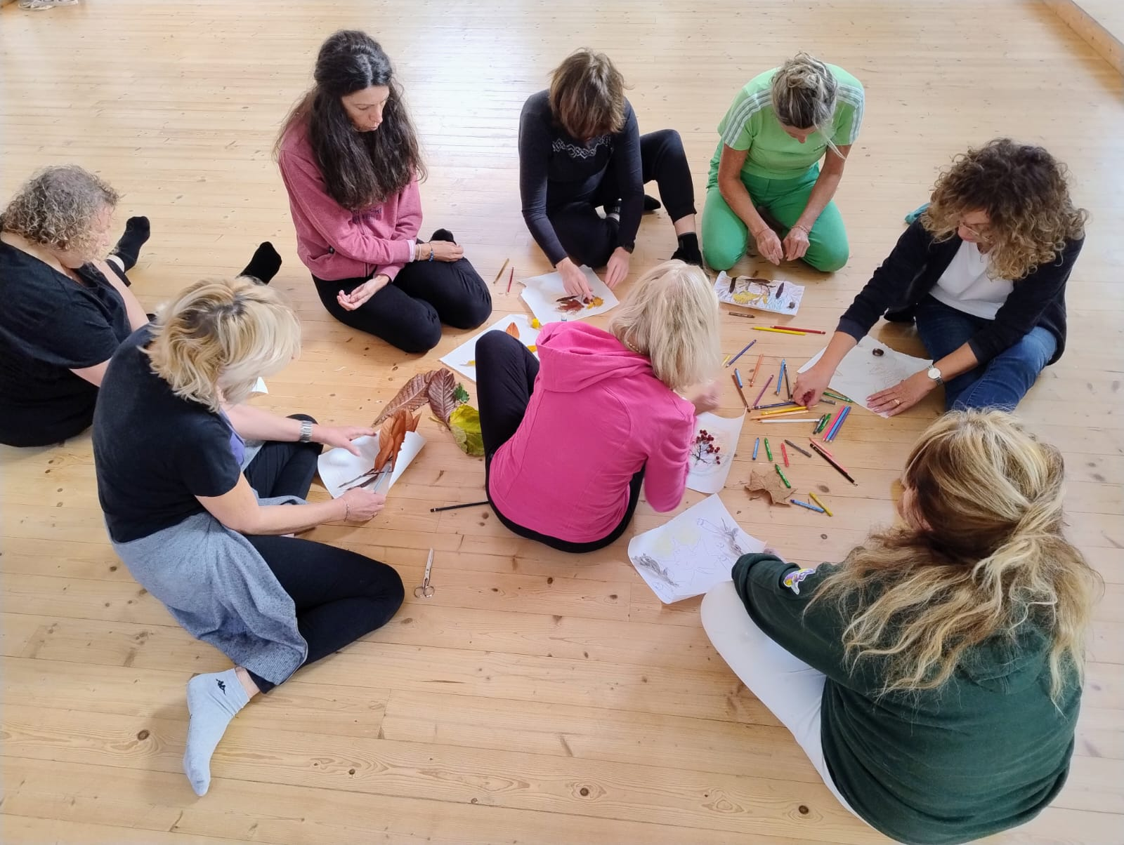

Dance Movement Therapy and Wise Motion to relieve long-term caregivers of emotional strain and cumulative stress: the case of DanceCARE project.
Flavia Galassi ¹ ² , Sara Santini ¹ , Rosa-María Rodríguez-Jiménez ³ , Marloes Shami - van Houten ⁴ , Hanna Poikonen ⁵
¹ Centre for Socio-Economic Research on Aging, IRCCS-INRCA - National Institute of Health and Science on Aging, Ancona, Italy
² Art Therapy Italiana (ATI) association, Via Barberia 13, Bologna, Italy
³ Universidad Francisco de Vitoria, Madrid, Spain and European Association of Dance Movement Therapy (EADMT)
⁴ Leyden Academy on Vitality and Aging, Netherlands and European Association of Dance Movement Therapy (EADMT)
⁵ WiseMotion Community, Helsinki, Finland
CONCEPT
The DanceCARE project is an Erasmus+ initiative in the field of adult education focused on health.
https://dancecare-project.eu/
According to the World Health Organization (WHO) reports, the number of care-dependent people worldwide is increasing every year, and a large percentage (almost 29%) of them are over 60. Co-existing chronic diseases are often associated with the need for health and social care for older adults. Moreover, the European Union's Long-Term Care (LTC) report (2021) underlines that ensuring sufficient numbers of qualified formal caregivers and providing support to informal caregivers of older people are key challenges in the European aging society.
Both informal and formal care is demanding and LTC caregivers are often isolated and at risk psychological distress and depression.
Caregiver BURDEN ¹ is a specific form of stress that we consider like a form of cumulative trauma. It tends to become chronic the longer the caring situation lasts and manifests itself in the most diverse and subjective forms:
sleep problems, appetite problems, mood decline, attention and concentration difficulties, memory difficulties, irritability and anxiety, persistent worry, somatization symptoms, ease of falling ill.
DanceCARE has addressed the need for support among long-term care (LTC) caregivers of older people, by applying the embodied cognition approach ² and offering group interventions and networking opportunities.
Scientific community has long discussed the need to put bodily processes at the center of education, care and mental health. It could be argued that there is no comprehensive intervention that does not also take the body into account.
This concept is slowly spreading and DanceCARE represents a valuable step towards a paradigm shift, adopting the mind-body methodologies of Dance Movement Therapy (DMT) ³ and Wise Motion (WM) ⁴ .
This innovative blended program has also produced a series of short videos to support mind-body practices, which can be found on the dedicated YouTube channel: https://www.youtube.com/@DanceCareErasmusProject
METHODS
Study Design
We adopted a pre-post convergent mixed-method design ³ that combine quantitative and qualitative tools and foresees three data collection waves:
At the baseline (T0) i.e. two weeks before the start of the training;
At mid-time (T1) i.e after the fourth session
Within two weeks from the conclusion of the intervention (T2)
At T0 and T2, caregivers completed a battery of validated psychometric tests and participated in a face-to-face (F2F) interview.
The pilot project was closely monitored through participant observations and the collection of art-based and embodied materials
Picture 1 -Outline of the Study Design
MAIN RESEARCH QUESTION: To what extent and how can the DanceCARE intervention change the perceived burden and depression levels of semi-formal and informal caregivers of older people with long-term care needs?
Other research questions include: whether the intervention also improves the quality of life of the elderly person receiving care, and whether the blended approach—which involves support through short online videos—is considered helpful and effective by the participants.
Table 1 - target groups, data collection, tools and timing
The DanceCARE program
The development of the intervention called "Body-mind education for stress relief", and the use of specific body-mind techniques was defined through the results of an online survey among 140 European dance movement therapists, followed by a focus-group involving 10 experts. A literature review was also conducted on the emotional needs and soft skills that caregivers of older adults should develop to cope with stress.
Based on these results, seven weekly body-mind group sessions, each lasting an hour and a half, were developed: some of the sessions draw on the neuroscientific principles of the WM method to promote physical relaxation and mindfulness, while others focus more on enhancing emotional and/or creative expression and are characteristic of the DMT approach.
Guidelines for BM trainers and other users have been developed and will be included in a handbook at the end of the project.
Table 2- Body-mind education for stress relief program
Pictures 2 and 3 - The program's first field trial took place simultaneously in Italy, Greece, and Spain in late 2025.
Results and KEY FINDINGS:
A total of 37 caregivers took part in the pilot study: participants were predominantly women (97.2%), with a mean age of 50.3 years; cared-for persons had a mean age of 84.6 years.
Baseline stress was high (mean=8.0/10), and between pre and post measures, these are the key findings:
BDI ⁵ report statistically significant decrease in the depression scores
ZBI ⁶ report slight decrease in the level of burden
CBI ⁷ doesn’t report any particular change in the overall dimensions (objective, psychological, physical,social and emotional)
Given that the stress burden on long-term caregivers, akin to cumulative trauma, and therefore typically increases gradually and continuously, we can say that even maintaining the same level or a statistically not significant reduction in the burden can be viewed as positive and encouraging outcomes.
Qualitative findings from interviews and collected art-based materials, confirmed and reinforced these findings: caregivers reported feeling calmer, more supported and more able to identify bodily signs of stress. Where workload scores were higher, some interpreted this as a sign of greater awareness rather than a worsening of the situation.
CONCLUSIONS:
Overall, the DanceCARE programme demonstrates that a relatively brief body-mind psychoeducational intervention can significantly reduce depressive symptoms in long-term informal caregivers and foster embodied self-awareness, social connection, and creative coping. In the future, it would be interesting to repeat the study and expand the sample population. Furthermore, incorporating biological measures of stress could generally strengthen this type of innovative intervention.
REFERENCIES:
[1] Del-Pino-Casado, R., Rodríguez Cardosa, M., López-Martínez, C., & Orgeta, V. (2019). The association between subjective caregiver burden and depressive symptoms in carers of older relatives: A systematic review and meta-analysis. PLoS ONE, 14(5), e0217648. https://doi.org/10.1371/journal.pone.0217648
[2] Foglia, L. and Wilson, R.A. (2013). Embodied cognition. Wiley Interdisciplinary Reviews: Cognitive Science, 4(3), pp.319–325.
[3] https://eadmt.com/
[4] https://wisemotionco.com/
[5] Katz-Buonincontro, J. (2024). Convergent mixed methods designs. In J. Katz-Buonincontro, How to mix methods: A guide to sequential, convergent, and experimental research designs (pp. 73–82). American Psychological Association. https://doi.org/10.1037/0000404-005
[6]Zarit, S.H., Reever, K.E. and Bach-Peterson, J. (1980). Relatives of the impaired elderly: Correlates of feelings of burden. The Gerontologist, 20(6), pp.649–655. https://doi.org/10.1093/geront/20.6.649
Novak, M. and Guest, C. (1989). Application of a multidimensional caregiver burden inventory. The Gerontologist, 29(6), pp.798–803. https://doi.org/10.1093/geront/29.6.798
[7] Beck, A.T., Ward, C.H., Mendelson, M., Mock, J. and Erbaugh, J. (1961). An inventory for measuring depression. Archives of General Psychiatry, 4, pp.561–571. https://doi.org/10.1001/archpsyc.1961.01710120031004

